Slide 1
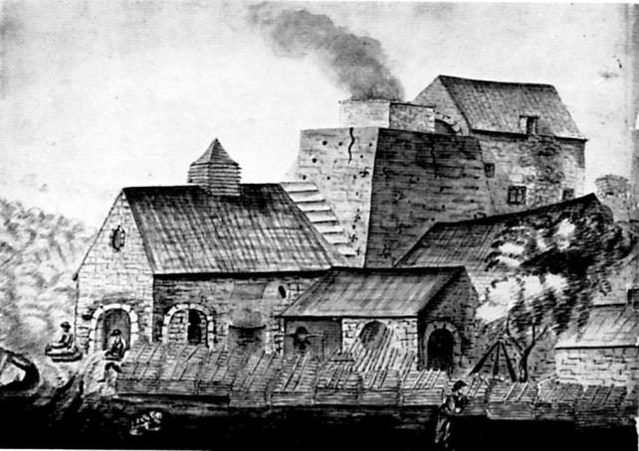
An ironworks, which was probably established late in the 16th century, was located at Pontygwaith (ST 079979) in the valley of the river Taff. This is to fire your imagination as to what a 16th century foundry may have looked like!

Slide 2
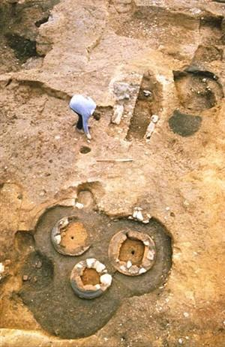
St Thomas Excavation site 1984.
Birdall Foundry dated to about 1525, closed in 1624/5 after the death of John Birdall.

Slide 3
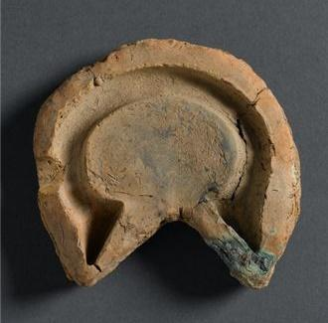
Manilla mould from Cowick Street dated to the 1500s
From the collections at RAMM, Accession No. 41/2005/5/1
This clay manilla mould was discovered by archaeologists working in Cowick Street, Exeter. The excavation took place on the site of the Birdall foundry in 1984, which also made bells and cauldrons.

Slide 4
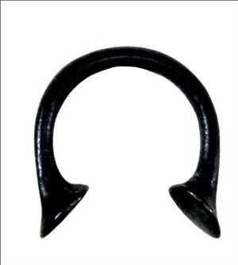
This manilla was Cast in Nigeria. From the collections at RAMM (World Cultures) The most popular African name for manillas, Okpoho, comes from the Igbo language, S.Eastern Nigeria.

Slide 5
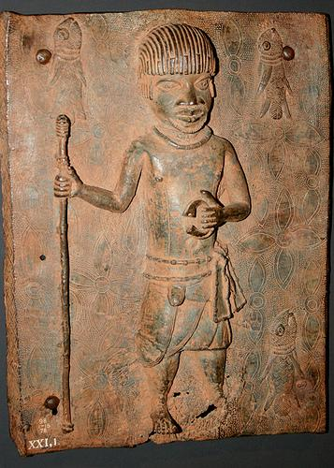
Kingdom of Benin, W Africa c.1600, man with Manillas The metals Bronze and Brass (red gold) were held in high regard in W. Africa. Quantities of the metal were acquired from European traders in the convenient bracelet form which the man on this plaque is holding. These bracelets were used as a trading currency commonly called 'Manillas', and were made in large numbers in Europe to be traded in W Africa for pepper, cloth, ivory, and other commodities. The metal for this plaque probably came from melting down a quantity of the manillas. Victoria and Albert Museum from the British Museum.
Kingdom of Benin
W Africa c.1600, man with Manillas
The metals Bronze and Brass (red gold) were held in high regard in W. Africa. Quantities of the metal were acquired from European traders in the convenient bracelet form which the man on this plaque is holding. These bracelets were used as a trading currency commonly called 'Manillas', and were made in large numbers in Europe to be traded in W Africa.
The metal for this plaque probably came from melting down a quantity of the manillas.
Victoria and Albert Museum from the British Museum.

Slide 6
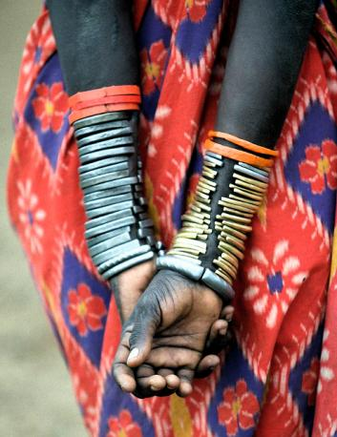
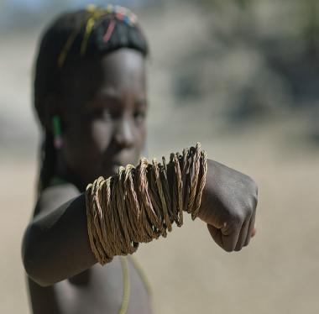
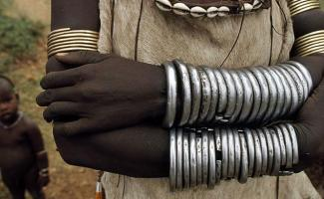
African women wore manillas as a sign of wealth and importance in West African culture. Wives often wore them to show how well off and important their husbands were. The famous Livingstone even noted a tribe where "those whose status did not entitle them to load their legs with rings imitated the walk of those who did." (p243). Ref : http://www.coincoin.com/I062.htm

Slide 7
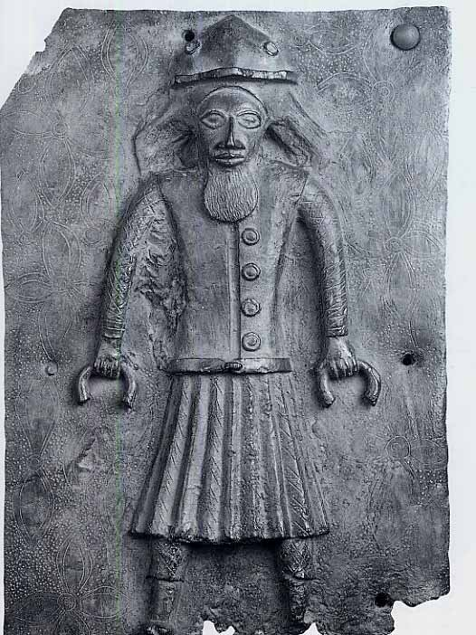
Plaque showing European man holding manilas.
Europeans records show early trading with West Africa. Exchanges of metal and cloth for various goods.
Benin, Royal Art of Africa, by Armand Duchateau

Slide 8
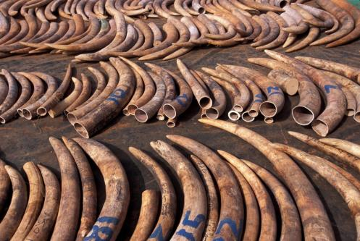
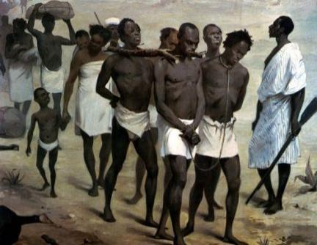
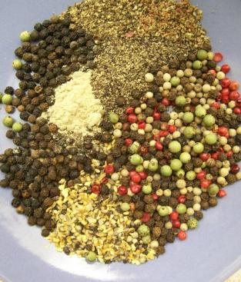
Various goods were traded, pepper, ivory, gold, tiger skins, cloth and slaves.
In Benin and the Slave Rivers of the Niger Delta, the price of a slave was 57 manillas in 1517.
Red Gold of Africa; E.W.Herbert

Slide 9
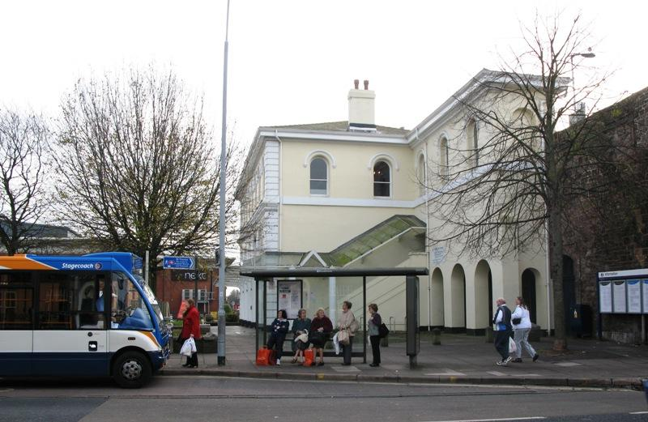
Birdall Foundry location in St Thomas Exeter, Cowick Street and Albany road.

Slide 10
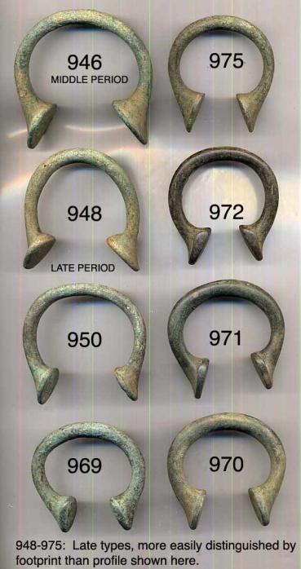
Birmingham manillas
It has long been known that foundries in Bristol and Birmingham made manillas for export in the 1700 and 1800s.
However, the Cowick Street mould is dated to the 1500s, making it the earliest evidence for the production of manillas in Britain….

Slide 11
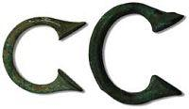
“Brasse Bracelts” from “Our Native Country”: The West Africa Trade and the Beginnings of English Manilla Manufacture By Thomas E. Davidson, Ph.D. Jamestown-Yorktown Foundation Senior Curator The Mkporo manilla, on the right, from a private collection , was cast in a mould almost identical to the Exeter Birdall mould. The Mkporo manilla is shown next to a smaller manilla in the Jamestown-Yorktown Foundation collection

Slide 12
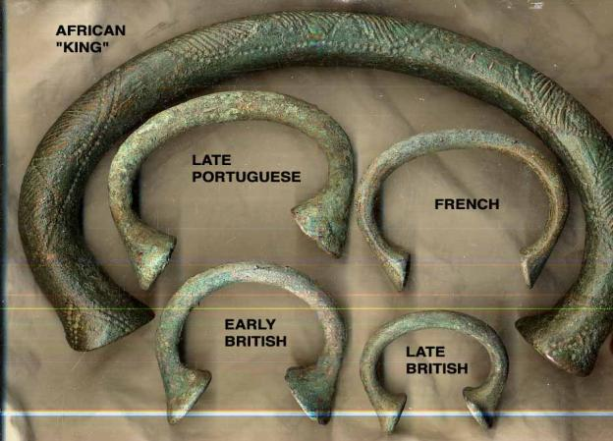
Various manillas The manilla, a lingering reminder of the slave trade, ceased to be legal tender in British West Africa on April 1, 1949.

Slide 13
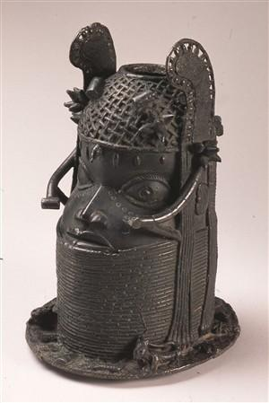
A Benin bronze head from the 1800s. This represents a divine king of the Benin.
Often the metal traded by the Africans was melted down to make the famous and beautifully crafted Benin heads
From the collection at RAMM (World Cultures). Accession No. 202/1915

Slide 14
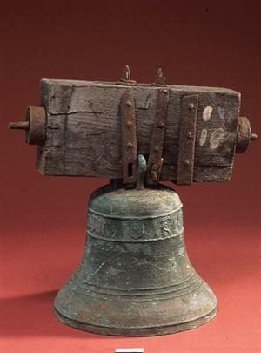
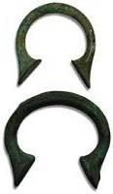
Plenty bells no manillas!? My question… throughout my research so far I have only found 2/3 sites that mention the manilla mould finds in St Thomas Foundry 1984, where as the bells are mentioned in every single one. Why is that?

Slide 15
Questions…
How is history told?
Does it depend on who you are? Where you come from?
Does it depend on your own history and life experiences?
How would you re-tell this story?
What would you go and research further that was related to this topic today?

