Slide 1
History of Exeter Mosque 35 years Ago

Slide 2
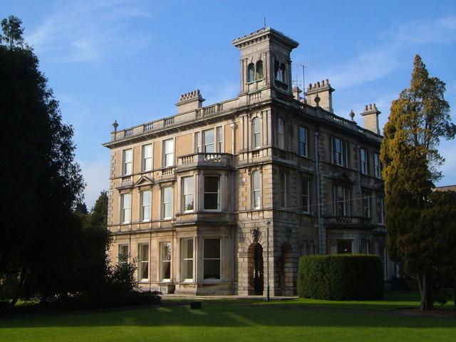
Exeter university -1970’s

Slide 3
1976-Exeter university student and local Muslim residents .

Slide 4
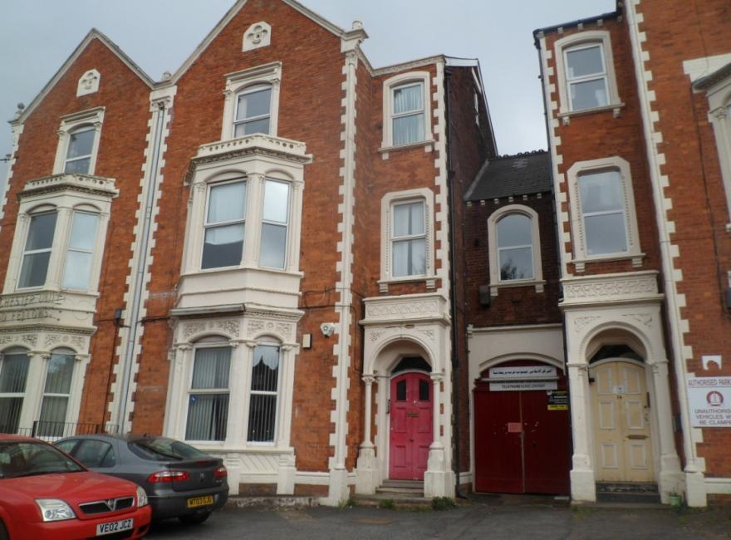
11 Sep . 1977
On the 11 Sep 1978 we invited local councillors, Bishop Business man to the opening of the Mosque.
On the 11 Sep 1978 we invited local councillors, Bishop Business man to the opening of the Mosque.
15 York Road

Slide 5
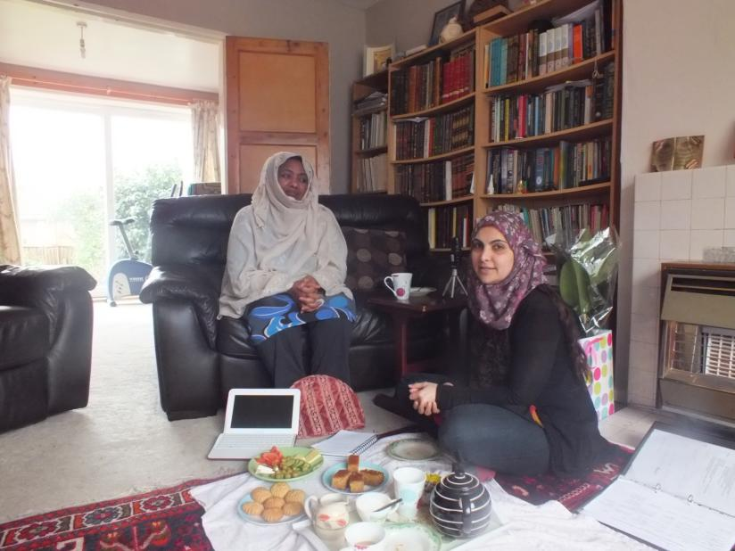
Sister Fatima the 3rd Imam’s wife

Slide 6
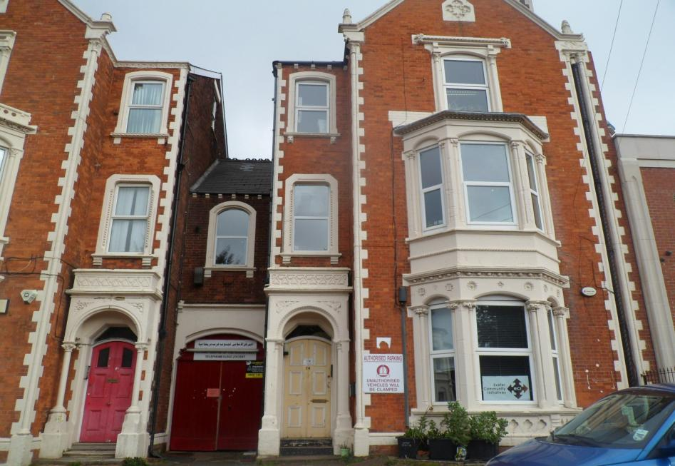
1995
14 York Road

Slide 7
2000

Slide 8
October 2011 the official opening the Mosque .

Slide 9
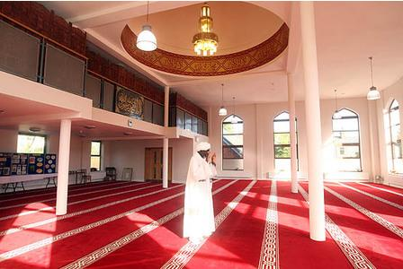
Today 2013 back in time we visit the mosque .

Slide 11
